Slide 1
Projectplan

Slide 2
Outline
Introduction
Generative music
Technologies
Soundgates
Workplan
Notes:
Introduction: Our Goal and how we want to achieve it
Maybe related work
Technologies: ReconOS, XPS, GMF
Soundgates: 3 Parts: Editor, Simulator, COSMIC

Slide 3
Introduction

Slide 4
Music
Traditional:
Musician performs and people perceive music
Trend:
Interact with music (even without knowledge)
  Cheering and shouting at a concert
  Guitar Hero, Rockband, DJ Hero, Singstar, …
Introduction
Notes:
Interact with music without musical knowledges or talent

Slide 5
2 Level of sound generation
Goal:
Generate music in Hardware on a FPGA
Level 1:
Musician builds a synthesizer
Level 2:
User interacts with system at runtime to modify the output
  Motion Sensors
  3D depth camera (i.e. Kinect)
Introduction
Notes:
2 Level: Mobile devices: motion and position sensors
3D depth camera tracks movement of body. map frequency to altitude of the left arm (ie)

Slide 6
Generative music

Slide 7
Approaches to generative music
Creative / Procedural
Interactive / Behavioural
Generative Music

Slide 8
Approaches to generative music
Creative / Procedural
Interactive / Behavioural
Generative Music

Slide 9
Creative / Procedural
Generate music from precomposed options
Musician writes song with different parts
  parts are exchangeable and randomly played
ie. “Mozart’s Musikalisches Würfespiel“
  next played section was randomly chosen by rolling a dice
Generative Music

Slide 10
Approaches to generative music
Creative / Procedural
Interactive / Behavioural
Generative Music

Slide 11
Interactive / Behavioural
Results from processes without discernable musical inputs
  uses:
  synthesized music, recorded or filtered samples
Music generation fully controlled by user input and interaction
  combined and filtered synthesized waveforms
  input modified with sensors
Generative Music
Notes:
This is our approach!

Slide 12
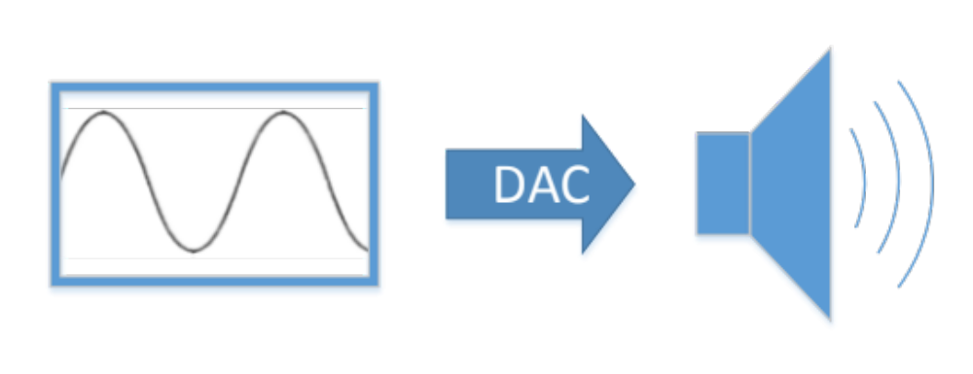
Generate Sound on a digital System
- Simple synthesizer
Generative Music
Notes:
Oscillator generates waveform (ie. SINE wave)
Sampled values are fed into Digital-To-Analog Converter to convert them into analog signal
→not pleasing to listen to but artifical
→ Possible to change frequency to play different notes

Slide 13
Soundgates
Titel

Slide 14
Soundgates
Editor
Simulator
COSMIC
Soundgates

Slide 15
Soundgates
Editor
Simulator
COSMIC
Soundgates

Slide 16
Editor
Musician builds/loads a patch
  consists of sound-components and connections
Sound-components
  wave generators (sine, sawtooth, rectangular)
  arithmetic functions (i.e. addition, multiplication)
  filters (i.e. low pass)
  mixers
  composite sound components
Soundgates

Slide 17
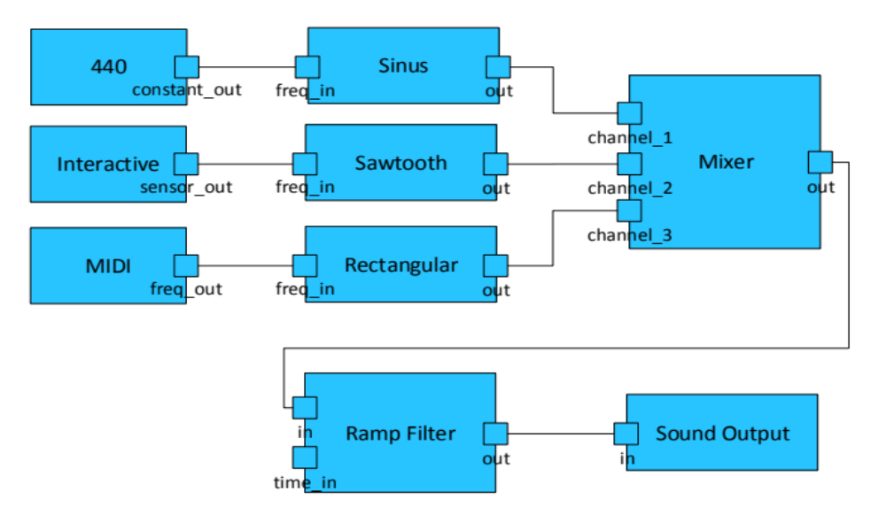
Example patch
Soundgates

Slide 18
Editor functions
Define interface of component
  possible to modify at runtime with sensors
Validates patch
  i.e. every port has an input
Export patch to VHDL code
Soundgates

Slide 19
Soundgates
Editor
Simulator
COSMIC
Soundgates

Slide 20
Simulator
Problem:
Testing the output is not possible until VHDL code is synthesized
Solution:
Test the developed system on PC
  Every component will be implemented in SW & HW
Soundgates

Slide 21
Soundgates
Editor
Simulator
COSMIC
Soundgates

Slide 22
COSMIC
Computer Scientists Making Music
The generated Bitstream is put on FPGA
Performer maps sensors to interfaces
  starts session by pushing a button
Creates input values with sensors
  music will be generated / modified
Soundgates
Notes:
performer or musician

Slide 23
Technologies
Titel

Slide 24
GMF
“Model Driven Software Development” approach for graphical editors
Eclipse framework
Specify Metamodel and generate software
Used for:
Create graphical editor to build patches and generate VHDL code
Technologies

Slide 25
ReconOS
Operating System on FPGA with soft core CPU
Linux
Integration of soft- and hardware threads
  communication abstracted by method calls
Used for:
Sensor input processed in software (IPC)
  modifies parameters of HW
Technologies
Notes:
Sensor input via ethernet / wifi (sockets IPC)

Slide 26
Open Sound Control (OSC)
Message based communication protocol
Independent of transport protocol
OSC message
  i.e.
  /synthesizer1/oscillator/sine1/freq “int32” 440
Used for:
Sensors will send OSC messages to FPGA system to modify parameters
Technologies

Slide 27
Workplan
Titel

Slide 28
Agile inspired development process
5 milestones
  each consists of a set of tasks
  approximately five to six weeks per milestone
“Github” for versioning and sharing of code
“Redmine” to represent milestones and tracking of tasks and bugs
Functional system at the end of every milestone
Workplan

Slide 29
Milestones
Prototyping infrastructure / environment
  fundamental infrastructure is prototyped
  no direct communication between them
Prototype of a digital synthesizer
  basic digital synthesizer can be modeled with the editor
  transform patch to HDL description
Workplan
Notes:
Open editor, place and connect dummy components; Simulate patch in simulator (proof of concept), HW: ReconOS environment + prototype I/o interface
basic components, constants, adders, delasy + rotary switches (on fpga)

Slide 30
Milestones
Polishing editing environment
  emulate the sound of an analog synthesizer (OF EVERY ANALOG SYN?)
  create Android application to stream senor data to the COSMIC system
  additional audio processing components
System integration and benchmarking
  evaluate system limits
Workplan
Notes:
3. Low/High pass filters ie., mixers, amplifier

Slide 31
Milestones
Documentation, Testing, Presentation
  polishing phase
Workplan
Notes:
3. Low/High pass filters ie., mixers, amplifier

